Slide 1


Customer Purchase Behaviour in Retail using Data Analytics
By
Ramkishore Prabakaran
MBT -09

Slide 2
Objective of this Project
This is a capstone to learn data analysis and graphical display utilizing Excel, SQL, and Power BI in a retail and e-commerce dataset.This is a capstone to learn data analysis and graphical display utilizing Excel, SQL, and Power BI in a retail and e-commerce dataset.This is a capstone to learn data analysis and graphical display utilizing Excel, SQL, and Power BI in a retail and e-commerce dataset.

Slide 3

Table of Contents
Sales Performance Analysis
Customer Insights
Inventory Management
Order Fulfillment Optimization
Financial Reporting
Staff Performance Evaluation
Market Trend Analysis
Business Growth Strategy

Slide 4
Sales Performance Analysis
As per the available data three shops together made 8.58M Dollars and made high at 3.85M Dollars During 2017. With a average sales of 238,305.24 Dollars per month
Average cost of a product is $ 1520.59 and most around 750 USD.
The Record sale observed in the month of April 2018 with the sales of 909k USD.
Baldwin Bikes contributes highest sales every year around 67% of total sales from New York City
Rowlett Bikes contribute less sales around 11% of total sales from Texas

Slide 5
Market Trend Analysis
The spring months of April, May, and June typically see a surge in bicycle sales in the United States. Several factors contribute to this seasonal trend
After surged high sales during april - may 2018 from June the sales got saturated.
Electra is the top brand is sales around 1729 cycles sold followed by 1235 cycles sold by Trek. Electra focus more on Affordable range cycles but Trek offers premium and professional cycles average cost of a Trek cycle is 2, 766 USD and Electra is 519 USD.

Slide 6
Customer Behaviour
Mountain Bikes are highest selling category and people prefers Trek brand Mountain bikes.
Children Bicycles are lowest selling with 3.82% contribution and Electra, Trek and Haro are major players in that category
Electric Bikes are new trending one with contribution of 11.89 percentage Trek and Sun Cycles are big players in this Categories
In Texas Road bikes sold more compared to New york city but New york City hold Highest no of Customers and cycles are marketed by Baldwin Bikes

Slide 7
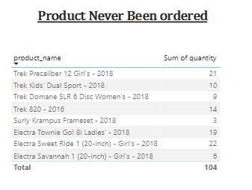
Inventory Management
Around 3.89M USD worth 4359 Cycles are in Stock
Ladies cycles Stocks are High in the inventory
Around 104 cycles and 8 Model cycles are not been ordered . In that Trek 820 2016 is the oldest stock with 14 Cycles not sold. Other models are 2018 so it may get sold.

Slide 8
Order Fulfilment
Average Processing Time during 2016,2017 is 2 Days but 2018 it is reduced to 1 day.
Processing time for Venita is 21 days others are 2 days

Slide 9
Financial Reporting
Month | Sum of sales
Jan | 984440.64
Feb | 748450.01
Mar | 957035.47
Apr | 1350508.59
May | 526455.79
Jun | 651222.35
Jul | 491531.73
Aug | 585941.06
Sep | 642621.25
Oct | 584587.89
Nov | 533476.07
Dec | 522718.03
Grand Total | 8578988.88
Shops | Sum of sales | Sum of Sales after discount | Discount Level | Total Discount in percentage
Baldwin Bikes | 5826242.21 | 5820137.301 | 6104.909325 | 0.10489287
Rowlett Bikes | 962600.76 | 961650.1748 | 950.585164 | 0.01633269
Santa Cruz Bikes | 1790145.91 | 1788302.681 | 1843.228735 | 0.03166985
Grand Total | 8578988.88 | 8570090.157 | 8898.723224 | 0.15289542

Slide 10
Financial Reporting
The Discount doesn’t increases or Decreases sales .
The average sales per customer is 1816.81 USD, it effects on total revenue
The Average cost of a product is 1212.7 USD and Cost of product ranges from 89.99 to 11999.99 USD
The Premium Product Sales was always good , if we focus on that it will increases the Sales

Slide 11
Staff Performance Evaluation
Jannette is the successful manager with sales conversion of 67.91
The average sales conversion of employee is 1428348.359 USD
Marcelene is the successful employee with sales conversion of 2,935,741.05 USD and Venita stands next with sales conversion of 2884396.25 USD.

Slide 12
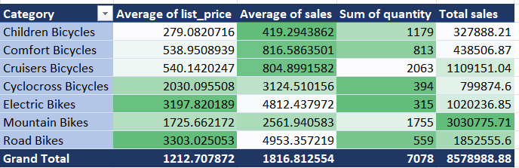
Business Growth Strategy
The Business Growth can be increased by expanding the division to other US states and here one important pricing strategy already worked well the average price is not high as road bike and electric cycle but the sales of mountain bikes is really good even not sold much quantity the sales goes well like Cruiser bike. If we can increase quantity of cycle sale it will help to increase our revenue

Slide 13
Business Growth Strategy
Category | Sales Target for Next 3 years | New List price | TARGET sales
Children Bicycles | 1500 | 282 | 423000
Comfort Bicycles | 1500 | 540 | 810000
Cruisers Bicycles | 3000 | 545 | 1635000
Cyclocross Bicycles | 600 | 2040 | 1224000
Electric Bikes | 1000 | 3200 | 3200000
Mountain Bikes | 2500 | 1730 | 4325000
Road Bikes | 700 | 3310 | 2317000
Total | 10800 | 11647 | 13934000
Target | 3722 | 32.22208745 | 5355011.12
 |  | Sales Increased | 38.43%
Without Increasing much on the price of cycle we can increase the no of cycles sold by increasing the branches and marketing . Especially E.bikes may outperform due to the new trends in E.vehicles

Slide 14
Thank you

